Slide 1
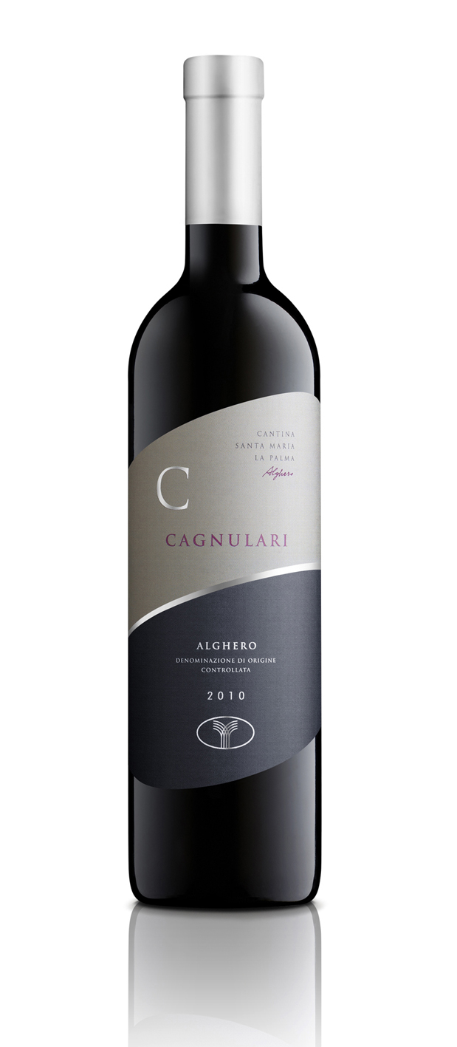
Cagnulari
Alghero D.O.C.
Vintage: 2017
Age of Vineyards: 10-20 years
Growing System: pruned-spur cordon-trained / Guyot
Variety: Cagnulari Alghero D.O.C.
Vine per Hectare: 3500
Quintals per Hectare: 70 q/h
Harvest: Last September
Processing and Fermentation: This native grape finds expression of its best qualities on the sandstone of the village “Arenosu”.
Analytic data: Alcohol 12,5 - 14%
Description: Ruby red, slightly tending toward violet. Strong, smooth, characteristic, with hints of liquorice and wild berries. Full, soft, strong and persistent, with clear suggestions of ref berry jam and Mascara cherry.
Serving suggestions: Good with cheeses that are aged to a moderate degree, rice dishes, boiled meats, roasts of red or white meat.
Other size: “Cagnulari Matusalem 6lt”, “Cagnulari Jeroboam 3lt”, “Cagnulari Magnum 1,5lt”

