Slide 1
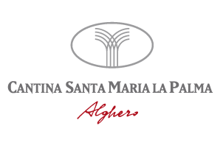
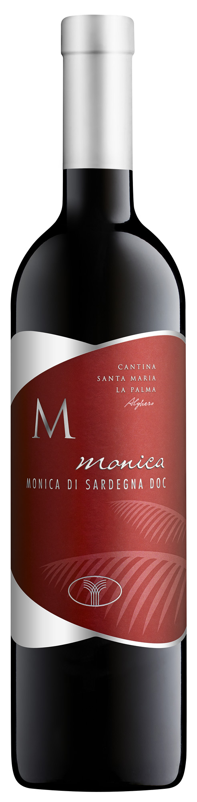
Monica
Monica di Sardegna D.O.C. Superiore
Vintage: 2016
Age of Vineyards: 5-15 years
Growing System: pruned-spur cordon-trained
Variety: Monica di Sardegna D.O.C. Superiore
Vine per Hectare: 4000
Quintals per Hectare: 80 q/h
Harvest: Beginning of October
Processing and Fermentation: In the past this grape type was the most popular in Sardinia, today it thrives in a few special areas like the sands of Lake Baratz.
Analytic data: Alcohol 12,5 - 14%
Description: Deep ruby red. Intense with fragrant and persistent scents of cherry and red fruits, and elegant spice notes. Dry and warm, pleasantly soft and delicate on the palate, well- structured with only slight acidity.
Serving suggestions: Good with vegetable soup and white meats.

